Slide 1
MCU KNOWLEDGE
Free-Run Timer and
Periodic Timer
Understanding the two fundamental MCU timer operating modes
BinhLV13 | October 2025

Slide 2
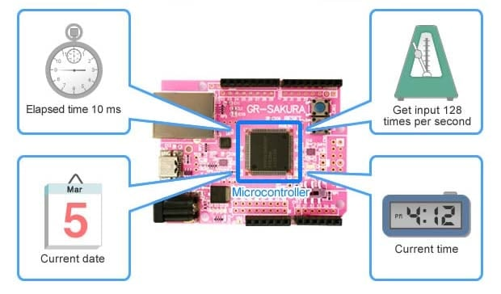
OVERVIEW
Introduction
Timers are among the most essential peripherals in embedded systems
They act as the system's precise hardware clocking mechanism
Timers run asynchronously, separate from the main CPU
They consume minimal processing time while keeping accurate time
Modern MCUs integrate multiple configurable timer modules
Two key operational modes: Free-Run Timer and Periodic Timer
Figure 1. Types of Processing that Utilize a Timer
2

Slide 3
SECTION 1
Abbreviations and Acronyms
No. | Item | Description
1 | MCU | Microcontroller Unit
2 | ARR | Auto-Reload Value
3 | RTOS | Real-Time Operating System
4 | ADC | Analog-to-Digital Converter
5 | PWM | Pulse Width Modulation
3

Slide 4
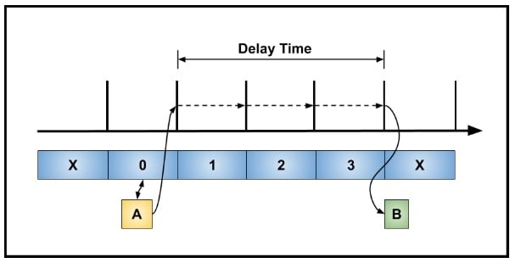
SECTION 2.1
Free-Run Timer: Overview
Also called a free-running counter
A hardware timer peripheral on the MCU
Once started, it counts up continuously from zero
Counts until it reaches its maximum value
Then it overflows (resets to zero) and continues
Operates with no stop condition or reload value, unlike a periodic timer
Figure 2. Free-run timer
4

Slide 5
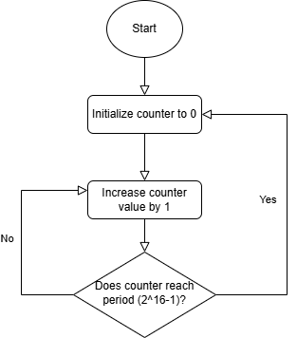
SECTION 2.2
Free-Run Timer: Key Characteristics
Continuous Counting: counts clock cycles from its time base without interruption
Overflow: rolls over to 0 at max value (e.g., 2^16-1 for a 16-bit timer); can trigger an interrupt
Time Reference: acts as a high-resolution, continuously running clock/timestamp
Note: When the counter reaches its maximum value, it rolls over to 0 and continues counting — this overflow can optionally trigger an interrupt.
Figure 3. Free-run counter loop (ends when timer stopped)
5

Slide 6
SECTION 2.3
Free-Run Timer: Common Uses
Ideal for measuring elapsed time and synchronization tasks
1
Measuring Elapsed Time
2
Input Capture
Read counter value at start and end of an event to calculate elapsed time, even across overflows
On external edge events, the timer's value is captured into a register for precise frequency/pulse width measurement
3
Generating Non-Periodic Delays
4
Implementing Timeouts
Software waits for the counter to reach a target value to create precise, one-off delays
Provides a reliable counter to check whether an operation has exceeded its allotted time
6

Slide 7
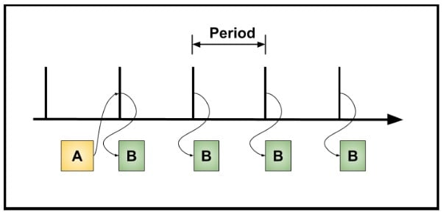
SECTION 3.1
Periodic Timer: Overview
A hardware peripheral configured to execute an action or trigger an interrupt
Operates at precise, regular time intervals
The most common mode for general-purpose timing
Acts as a reliable heartbeat for the MCU's time-based operations
Figure 4. Periodic timer
7

Slide 8
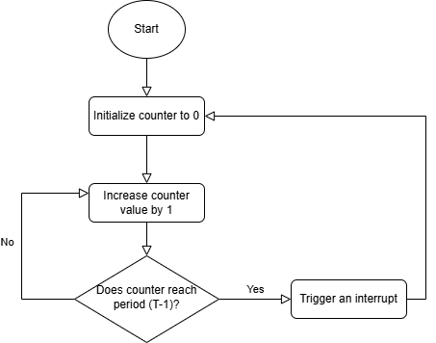
SECTION 3.2
Periodic Timer: Key Characteristics
Based on a counter and a compare/period register:
Time-based Configuration: system clock passes through a prescaler (frequency divider) that sets the timer resolution
Period Setup: the programmer writes a specific value, the period or ARR, into a dedicated register
Counting and Reset: the loop runs for time period T, ending when the timer is stopped
Repetition: the process repeats automatically and precisely, producing a continuous stream of events
Figure 5. Periodic counter loop (ends when timer stopped)
8

Slide 9
SECTION 3.3
Periodic Timer: Common Uses
Fundamental for functions that must run reliably and on time, independent of program execution speed
1
2
3
Task Scheduling (RTOS Tick)
Data Acquisition
Status Updates
Generates the tick interrupt for an RTOS, letting the OS switch between software tasks at fixed intervals
Periodically triggers other peripherals, such as an ADC, to sample sensor data at a fixed rate
Used to update displays, blink status LEDs, or check input states at regular intervals
9

Slide 10
SECTION 4
Comparison
Feature | Free-Run Timer | Periodic Timer
Primary Goal | Measure Elapsed Time (Timestamping) | Generate Regular Events (Time-based)
Counting Mode | Counts continuously from 0 to max (e.g., 2^16-1), then overflows back to 0 | Counts up to a user-defined Period/Compare value, then resets to 0
Reset / Reload | Resets only on a full overflow or explicit software reset | Resets automatically upon Compare Match
Output / Event | Overflow interrupt or Input Capture snapshot of current count | Compare Match interrupt at a precise, short interval
Event Time | Variable — fixed by the full timer size | Fixed and accurate, set by the user's Period
10

Slide 11
SECTION 4 (CONT.)
Comparison: Key Use Cases
Free-Run Timer
Periodic Timer
Timestamping events (Input Capture)
Measuring arbitrary pulse widths or time intervals
RTOS Tick (system heartbeat)
Periodic interrupts for task scheduling, e.g. sampling sensors
Generating PWM signals
11

Slide 12
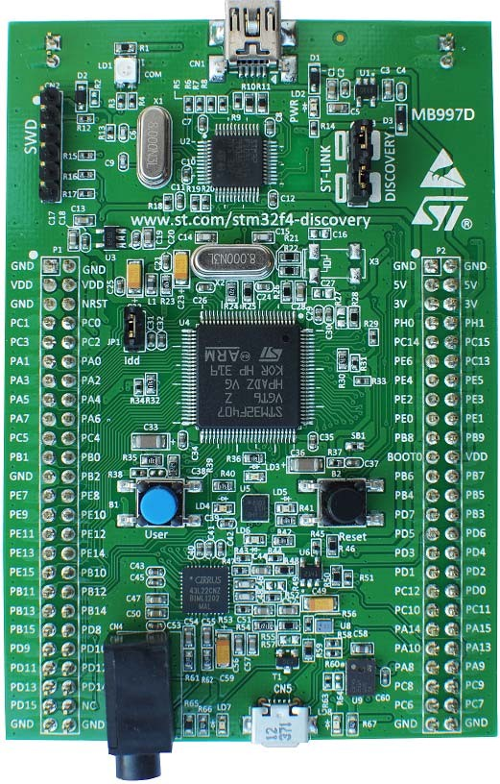
SECTION 5
Code Example
Reference: Verification-Freerun-and-Periodic-Timer.xlsx — verification and debugging details for both timer modes
Hardware: Discovery kit with STM32F407VG MCU
Order code: STM32F407G-DISC
Figure 6. STM32F407G-DISC1 kit (picture not contractual)
12

Slide 13
SECTION 6
Reference
No. | Item | Description
1 | UM1472 | Discovery kit with STM32F407VG MCU user manual
2 | RM0090 | STM32F405/415, 407/417, 427/437 and 429/439 advanced Arm-based 32-bit MCUs reference manual
3 | DS8626 | Datasheet for STM32F405xx and STM32F407xx microcontroller lines
4 | AN4013 | Application note: introduction to timers for STM32F4 series MCUs
5 | UM1725 | User manual: STM32F4 HAL and low-layer drivers
13

Slide 14
SECTION 7
Revision History
Date | Revision | Changes
22-Oct-2025 | 1 | Initial release
14

Slide 15
SUMMARY
Key Takeaways
Free-Run Timer
Periodic Timer
Counts continuously to max value, then overflows
Best for measuring elapsed time and Input Capture
Variable event time, fixed by full timer size
Counts to a user-set Period (ARR), then resets
Best for RTOS ticks, ADC sampling, PWM, status updates
Fixed, accurate event time set by the user
Thank you | BinhLV13, October 2025

